Slide 1
L1088 Environmental Economics
Richard S.J. Tol

Slide 2
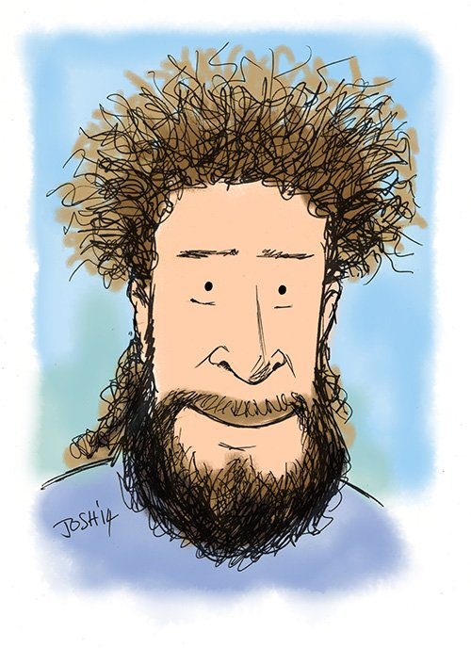
About me
Dr Richard S.J. Tol MAE
Professor of economics
Jubilee 281
Office hours
Tue 10:00-14:00
Or by email: r.tol@sussex.ac.uk
Key interests: climate, energy, environment

Slide 3
The Course
A comprehensive introduction to the economic theory of environmental pollution and environmental policy
Prior knowledge
micro, macro, calculus
Book
C.D. Kolstad (2011), Intermediate Environmental Economics: International Edition (2nd Edition), Oxford University Press, ISBN 0199732655
Videos complement lectures
Lectures: Tue, 3-5 pm, Shawcross AS01
Seminars: Tue, 2-3 pm, Jubilee G36

Slide 5
0 Introduction
1 Social choice
2 Externalities and public goods
3 Decision analysis
4 Valuation: Aims and purpose
5 Valuation: Revealed preferences
6 Valuation: Stated preferences
7 Direct regulation
8 Market-based instruments
9 Complications with instruments
10 Growth and the environment
11 Green accounting

Slide 6
Seminars
Problem sets
Readings
Exam preparation

Slide 7
Grades
70% unseen exam*
30% 2,500 word essay
*exchange students who leave before Christmas will get an alternative assignment (yet to be decided)
Quizzes on Canvas are graded but do not count, for revision only

